Slide 1

“Develop a passion for learning.”
Develop a Microservice with Python Flask in one day.
1
1
1
Class starts at 9AM
1

Slide 2

Microservice Application Architecture
“The Microservice architectural style is an approach to developing a single application as a suite of small services, each running in its own process and communicating with lightweight mechanisms, often an HTTP resource API.”
- Martin Fowler
© 2021 by Innovation In Software Corporation
2

Slide 3
Microservice Application Architecture
By the end of the course you will:
Have a clear understanding of Flask Microservices and Restful APIS
Gain hands on experience working with microservices in a range of labs
Have the skills and information necessary to start writing Microservices with Python and Flask
© 2021 by Innovation In Software Corporation
3

Slide 4


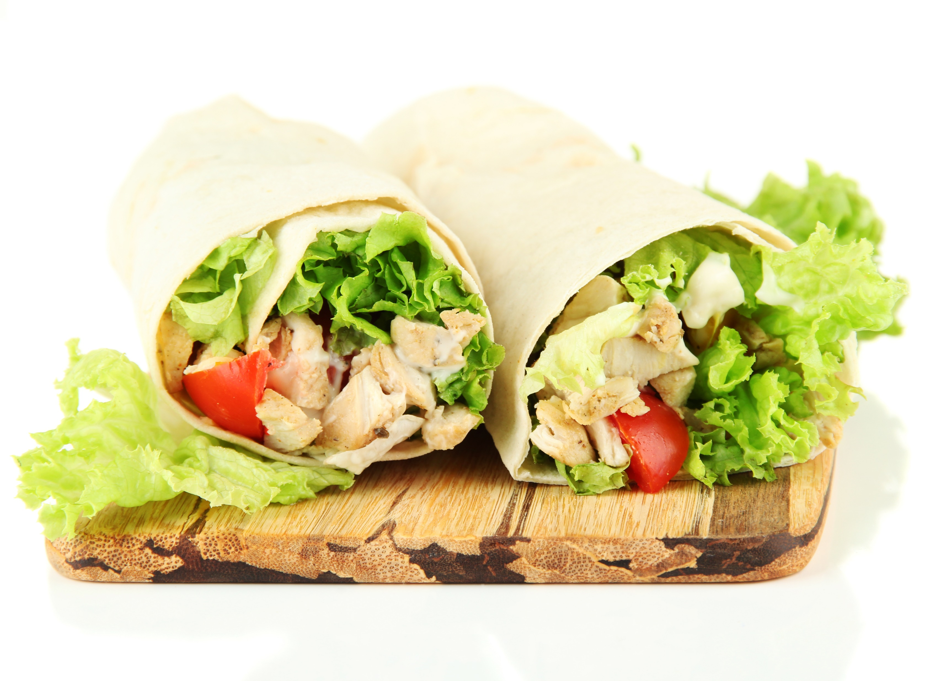
logistics
Class Hours:
Start time is 9:00am
End time is 4:30pm
Class times may vary slightly for specific classes
Breaks mid-morning and afternoon (15 minutes)
Telecommunication:
Turn off or set electronic devices to vibrate
Reading or attending to devices can be distracting to other students
Try to delay until breaks or after class
Miscellaneous
Courseware
Bathroom
Fire drills
Lunch:
Lunch is noon to 1:15pm
Yes, 1 hour and 15 minutes
Extra time for email, phone calls, or simply a walk.
© 2021 by Innovation In Software Corporation
4

Slide 5
Course structure
This is a hands-on workshop. Less talk more labs
5
© 2021 by Innovation In Software Corporation

Slide 6
Schedule of Events
Day 1
Introduction
Understanding Microservices and Restful APIs
Introduction to Python and Flask
Creating restful services with Flask
Flask Restful API modules
Connecting a microservice to Databases with
Python SQLAlchemy
Deploying a Microservices to Docker and
Kubernetes platform
Optional Lunch-Time Lab
Installing Docker/Kubernetes on your local machine
Demos and Labs
Lab: Setting up Development Environment:
IDE, Python, pip, Flask and Postman
Lab: Hello world Flask App
Lab: MVC Flask application
Lab: SQL Alchemy with Flask
Lab: Flask Microservices modules
Lab: Creating a sample Restful API
Lab: Dockerize the microservice
Lab: Run the Microservice on a Kubernetes cluster
© 2021 by Innovation In Software Corporation
6

Slide 7




Meet Your Instructor
Jordan Rinke
Principal Engineer focused on cloud native/hybrid technologies with 20 years of experience.
Twitter:
E-Mail:
LinkedIn:
Expertise in:
Cloud
Automation
Kubernetes
Hyperscale
Hyperedge
@jordanrinke
jordan@rin.ke
https://www.linkedin.com/in/jordanrinke/

Slide 8
Introduction
Name
Title or your role
Languages/Areas of expertise
Why are you taking this workshop?
Rate yourself (1-5) 1 being a beginner, 5 being a SME on
Python
Flask
Microservices/restful APIs
Location
© 2021 by Innovation In Software Corporation
8

Slide 9

Questions?
Does anyone have any questions before we begin?
9
© 2021 by Innovation In Software Corporation

Slide 10
Part 1: Introduction
10
© 2021 by Innovation In Software Corporation

Slide 11
Microservices
Microservices are a set of small, independent, composable services.
Each service can be accessed by way of a well-known API format such as REST, GraphQL, gRPC or in response to event notifications.
This architectural style de-constructs business processes to their most basic level by creating small, separate processes that then replace large, single applications.
11
© 2021 by Innovation In Software Corporation

Slide 12
Why Microservices?
Less complexity (maybe)
Awesome for teams with varying degrees of experience
Scaling flexibility
More reliability
Less coupling
More choice of Languages (Polyglot)
Agility: Deploy/upgrade while running.
So where is performance in this list?
12
© 2021 by Innovation In Software Corporation

Slide 13
Why Microservices Architecture?
Adopting this architecture increases the potential benefits of complex IT initiatives
Agility
Agility allows organizations to deliver new products, functions, and features quicker
Reduce time to market
Independent components move new features into production quicker and provide more flexibility for piloting and prototyping, thus reducing time to market
Composability
Composability reduces development time, provides a compound benefit through reusability over time, and guarantees system scalability
Comprehensibility
Comprehensibility of the software system simplifies development planning, increases accuracy, and accelerates new resource integration
Polyglotism
Polyglotism permits the use of the right tools for the right task, thus accelerating technology introduction and increasing solution options
Cost reduction
Reduce cost at operating speed by reducing the overall cost of designing, implementing, and deploying services
13
© 2021 by Innovation In Software Corporation

Slide 14
Lifecycle of a microservice
On startup, the microservice registers with the service registry, or is “discovered” by it
The load balancer watches the registry and updates itself to include the new microservice
The new service starts receiving traffic from the load balancer
If more than one instance of the service exists, the traffic is split among them
The service sends “keep-alive” signals, or responds to periodic health checks
When the service is stopped, or stops sending keep-alives, or fails a health check, it is removed from the registry, and in turn from the load balancer
14
© 2021 by Innovation In Software Corporation

Slide 15
WHY Python?
Python is one of the fastest growing programming languages today
Has surpassed java to be number 1 in the world as of January 2021 (see next slide)
Can be used for many fields such as AI, Machine learning,
Web Development
Good documentation from python foundation
Huge community
English like syntax and easy to read
Note: Python code uses indentation so pay attention to your indentation
15
© 2021 by Innovation In Software Corporation

Slide 16
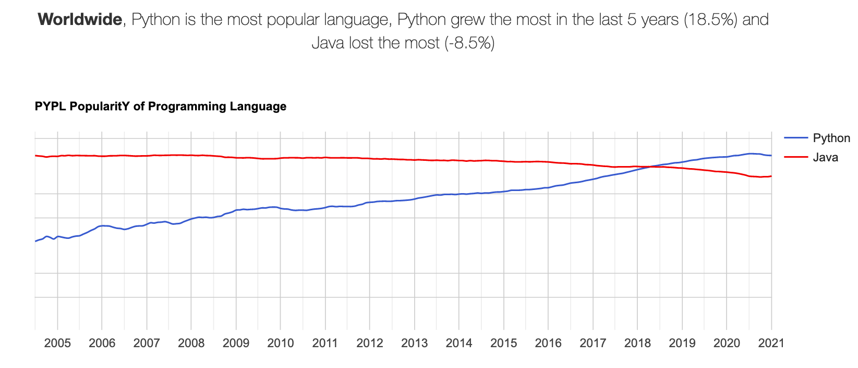
WHY Python and Flask
https://pypl.github.io/PYPL.html
16
© 2021 by Innovation In Software Corporation

Slide 17
WHY Flask ?
2 very popular Python framework:
Django and Flask. Django is older, more mature, and a little bit more popular.
Flask is a microframework. Goal is to keep it simple but extensible
It does not impose a way of doing things unlike Django (not as opinionated), such as what database to use or what template engine to choose
Flask applications are known for being lightweight, especially when compared to Django applications.
Good documentation
https://flask.palletsprojects.com/en/0.12.x/
Being lightweight, easy to adopt, well-documented, and popular, Flask is a very good option for developing RESTful APIs
17
© 2021 by Innovation In Software Corporation

Slide 18
The Flask framework
Flask is more of a glue that sticks together two popular frameworks:
Werkzeug (@ http://werkzeug.pocoo.org/): a WSGI (Web Server Gateway Interface) library for Python, which includes a URL routing system, fully featured request and response objects and a powerful debugger. (WSGI is a specification for simple and universal interface between web servers and Python web applications.)
Jinja2 (@ http://jinja.pocoo.org/): a full-feature template engine for Python.
18
© 2021 by Innovation In Software Corporation

Slide 19
The Flask framework FEATURES
a WSGI compliance interface.
URL routing and Request dispatching.
Secure cookies and Sessions.
a built-in Development Web Server and Debugger.
Unit test client for unit testing that facilitates write-test-first.
Jinja2 templates (tags, filters, macros, etc).
19
© 2021 by Innovation In Software Corporation

Slide 20

Flask Pros & Cons
20
© 2021 by Innovation In Software Corporation
Notes:
In a monolith, interconnected inter-process communication is fast and with concurrency can perform very well. But inevitably, as some layer, there becomes a bottleneck for resources. Such as the case in a bottleneck accessing various back-end systems and/or databases.

Slide 21
Flask Pros & Cons
Pro’s
Freedom to innovate
Defacto flask framework for restful APIs
Get things running with minimal code
Lots of extensions available to use
e.g flask-restful, flask restless
Good documentation
Con’s
There is something to say about standards. Since no standards, no unified way of doing things
So many different ways of doing something(Snowflake concept)
21
© 2021 by Innovation In Software Corporation

Slide 22
Flask Frameworks
2 very popular Python framework:
Django and Flask. Django is older, more mature, and a little bit more popular.
Flask is a microframework. Goal is to keep it simple but extensible
It does not impose a way of doing things unlike Django (not as opinionated), such as what database to use or what template engine to choose
Flask applications are known for being lightweight, especially when compared to Django applications.
Good documentation
https://flask.palletsprojects.com/en/0.12.x/
Being lightweight, easy to adopt, well-documented, and popular, Flask is a very good option for developing RESTful APIs
22
© 2021 by Innovation In Software Corporation

Slide 23
Part 2: restful web services
23
© 2021 by Innovation In Software Corporation

Slide 24
Framework vs ryo
Framework
defines the structure and provides a set of libraries for common tasks
Written by experts and code well tested
Extra work needed to learn the framework
But could make you more productive so the time is worth the effort
full-stack Python framework examples are Django, TurboGears, web2py; non-full-stack frameworks examples are Flask, Pyramid.
Roll-Your-Own (RYO)
need to write tens of thousand lines of boiler-plate codes, that are already provided by a framework
your codes are most likely messy, buggy, un-tested and un-maintainable
Lot of time needed to do even simple tasks
24
© 2021 by Innovation In Software Corporation

Slide 25
Some definitions
XML [eXtensible Markup Language] is a standardized format for storing and sending data. Similar to HTML, XML stores data by wrapping it in descriptive tags.
JSON [JavaScript Object Notation] is similar to XML in that it also stores data and enables you to send data in a standardized format. JSON just uses a different, object-based, methodology for systematically storing data.
HTTP [HyperText Transfer Protocol] is the foundation of transferring data and communications on the internet.
SOAP [Simple Object Access Protocol] is a messaging protocol used for exchanging structured information[XML data] over a network.
REST [REpresentational State Transfer] is a standardized architectural style that can be used when creating a web API.
Web applications (Web app) are computer programs that are accessed over the internet through a computer’s web browser.
25
© 2019 by Metropolitan Airport Commission IT

Slide 26
Restful APIS: What is REST
The characteristics of a REST system are defined by six design rules:
Client-Server: There should be a separation between the server that offers a service, and the client that consumes it.
Stateless: Each request from a client must contain all the information required by the server to carry out the request. In other words, the server cannot store information provided by the client in one request and use it in another request.
Cacheable: The server must indicate to the client if requests can be cached or not.
Layered System: Communication between a client and a server should be standardized in such a way that allows intermediaries to respond to requests instead of the end server, without the client having to do anything different.
Uniform Interface: The method of communication between a client and a server must be uniform.
Code on demand: Servers can provide executable code or scripts for clients to execute in their context. This constraint is the only one that is optional.
26
© 2021 by Innovation In Software Corporation

Slide 27
Restful Web service
The REST architecture was originally designed to fit the HTTP protocol that the world wide web uses.
Central to the concept of RESTful web services is the notion of resources.
Resources are represented by URIs. The clients send requests to these URIs using the methods defined by the HTTP protocol, and possibly as a result of that the state of the affected resource changes.
The HTTP request methods are typically designed to affect a given resource in standard ways. This follows the CRUD verbs as listed below
27
© 2021 by Innovation In Software Corporation

Slide 28
Restful Web service
HTTP Method | Action | Examples
GET | Obtain information about a resource | http://example.com/api/orders (retrieve order list)
GET | Obtain information about a resource | http://example.com/api/orders/123 (retrieve order #123)
POST | Create a new resource | http://example.com/api/orders (create a new order, from data provided with the request)
PUT | Update a resource | http://example.com/api/orders/123 (update order #123, from data provided with the request)
DELETE | Delete a resource | http://example.com/api/orders/123 (delete order #123)
28
© 2021 by Innovation In Software Corporation

Slide 29
Web service vs APIs and RESTFUL APis
APIs are application interfaces, meaning that one application is able to interact with another application in a standardized way.
Web services are a type of API, which must be accessed through a network connection.
REST APIs are a standardized architecture for building web APIs using HTTP methods.
29
© 2019 by Metropolitan Airport Commission IT

Slide 30
Part 4: labs and hands-on workshops
30
© 2021 by Innovation In Software Corporation

Slide 31
Lab: Setup your development environment
31
© 2021 by Innovation In Software Corporation

Slide 32
Setting up the environment: Workshop. Refer to lab doc
Install python
Install pip
Install flask
Create a virtual environment (pipenv and python –m)
Install sublime text editor or visual studio or Wing
https://wingware.com/downloads/wing-personal
Create a hello world flask application
32
© 2021 by Innovation In Software Corporation

Slide 33
Lab: create flask web services (hello world and MVC )
33
© 2021 by Innovation In Software Corporation

Slide 34
LAB: use alchemy library with your microservice
34
© 2021 by Innovation In Software Corporation

Slide 35
Lab: create a flask Restful web service from scratch
35
© 2021 by Innovation In Software Corporation

Slide 36
Lab: create a flask Restful webservice using flask-restful
36
© 2021 by Innovation In Software Corporation

Slide 37
Restful Api Labs
Installing flask and flask_restful
Create and initialize the file
Create the data stored in a dictionary
Create object List class and route
Create get() and post() methods for List()
Define object class and route
Create get(), update() and delete() methods
Test the endpoints
37
© 2019 by Metropolitan Airport Commission IT

Slide 38
Lab: create a flask Restful webservice using flask-restless
38
© 2021 by Innovation In Software Corporation

Slide 39
Lab: Deploy A Microservice to Docker and Kubernetes
39
© 2021 by Innovation In Software Corporation

Slide 40
Lab: possibly more labs(if time permits)
40
© 2021 by Innovation In Software Corporation

Slide 41
Thank You For Attending
Please do the course evaluation provided by the session coach:
http://www.metricsthatmatter.com/student/evaluation.asp?k=16324&i=VC00466629
41
© 2021 by Innovation In Software Corporation

